Slide 1
Men-Stack App
MEN-Stack Project on an app that can track recipes. This application will allow users can share and discover recipes. The app will include features such as user profile, nutrition tracking, and recipe storage.

Slide 2
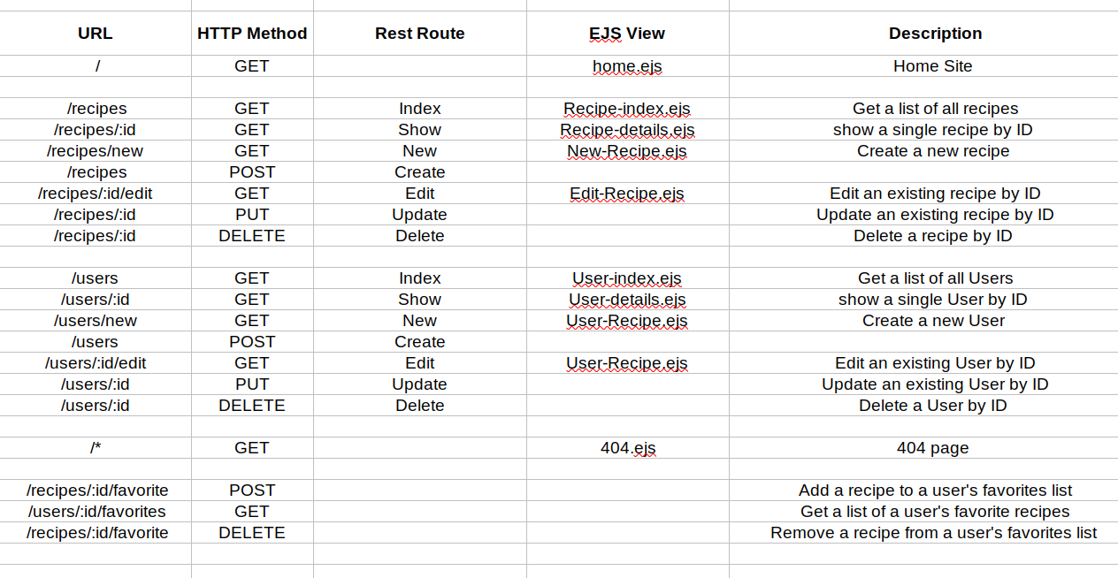
Route Table

Slide 3
Recipe Tracking
Recipes Create Recipe Profile
New to the Site?
Home
Featured Recipes
Click Here!
Food Pic
Mexican Recipes
Italian Recipes
Food Pic
Food Pic
Food Pic
Food Pic

Slide 4
Recipe Tracking
Recipes Create Recipe Profile
Recipes Create Recipe Profile
Recipes Create Recipe Profile
Recipes Create Recipe Profile
Recipes
Mexican Recipes
Italian Recipes
Food Pic
Food Pic
Food Pic
Food Pic
American Recipes
Greek Recipes
Food Pic
Food Pic
Food Pic
Food Pic

Slide 5
Recipe Tracking
Recipes Create Recipe Profile
Recipes Create Recipe Profile
Recipes Create Recipe Profile
Recipes Create Recipe Profile
Food 1:
Food Pic
Edit
Add to Favorites?
Delete
Category:
Mexican Recipes
Name of Recipe:
This is text, This is text
Description:
This is text, This is text

Slide 6
Recipe Tracking
Recipes Create Recipe Profile
Create
You Want to Create a Recipe?
Fill out the form below:
Name of Recipe:
Input
Input
Description:
Input
Ingredients:
Input

Slide 7
Recipe Tracking
Recipes Create Recipe Profile
Create
You Want to Create a Recipe?
Fill out the form below:
Directions:
Input
Nutrition Facts
Calories:
Input
Carbs:
Input

Slide 8
Recipe Tracking
Recipes Create Recipe Profile
New User
You Want to Create a Profile?
Fill out the form below:
Name:
Input
Input
Email:
Input
Username:
Input
Profile Picture (url for now):
Input

Slide 9
Recipe Tracking
Recipes Create Recipe Profile
Profile
User Name
Picture
Email
Favorite Recipes
Edit
Food Pic
Food Pic
Food Pic
Delete
Delete
Delete
Delete
Delete
Delete

